Slide 1

Department of BES-II
BASIC ELECTRICAL AND ELECTRONIC CIRCUITS
COURSE CODE : 23EC1203
Topic:
Operation of the diode, Diode as switch
Session – No. 08a

Slide 2



AIM OF THE SESSION
To familiarize students with the basic concept of Diodes and it’s applications.
INSTRUCTIONAL OBJECTIVES
This Session is designed to:
Demonstrate the Operation of Diodes
Describe the working principle of Diode with differnt biasing conditions.
List Out Various Types of Diodes
Describe the Application of Diodes as Switches
LEARNING OUTCOMES
At the end of this session, you should be able to:
Define diodes and its characterstics
Describe Principles of Diode
Summarize Advantages and Considerations of Diode Switches

Slide 3
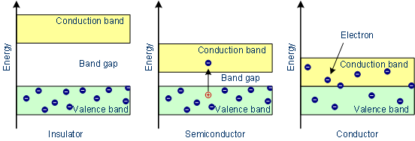
Insulator, Semiconductor & Conductor

Slide 4
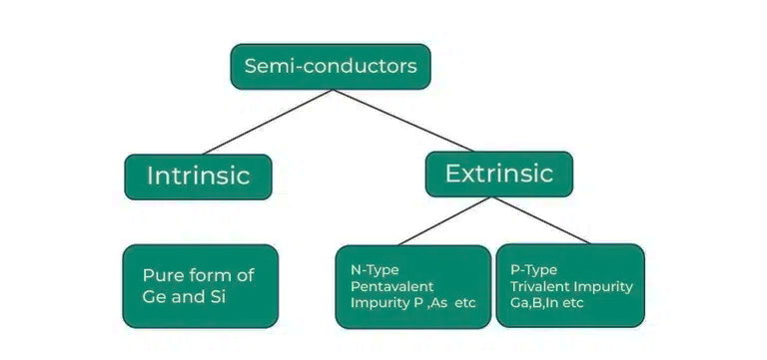
Semiconductors & Types
Form the core of diodes, transistors, and integrated circuits (ICs).
Used for switching, amplification, and signal processing.
Basis of modern electronics (transistors, ICs, etc.).

Slide 5
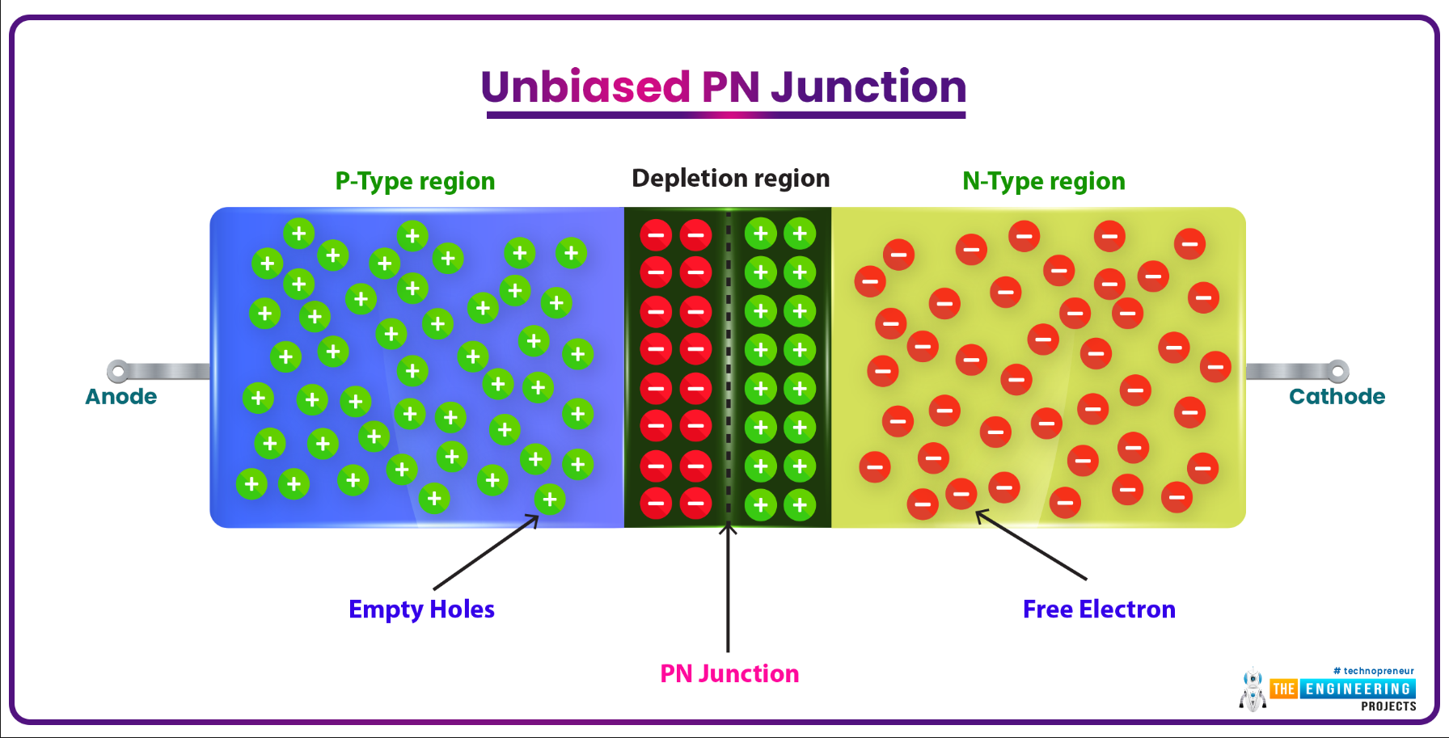
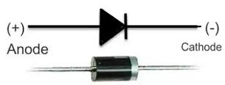
PN Junction Diode
A semiconductor diode that allows current flow in only one direction.
Types of diodes: PN Junction, Zener, LED, Schottky, etc.
Barrier potential: Typically 0.7V for Silicon, 0.3V for Germanium.
P-Type: Silicon doped with trivalent impurities
N-Type: Silicon doped with pentavalent impurities

Slide 6
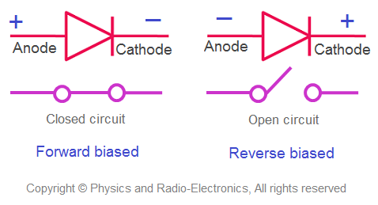
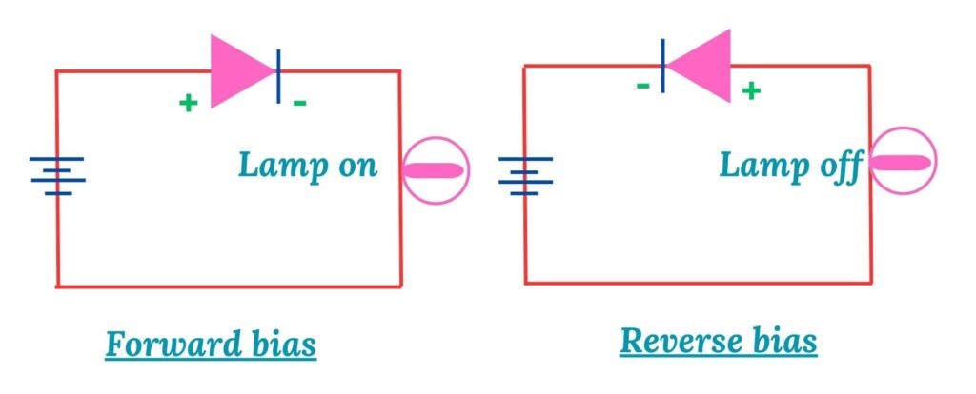
Diode Forward and Reverse Bias
In Forward bias, diode acts as low resistance (closed circuit) path.
In Reverse bias, diode acts as high resistance (open circuit) path.

Slide 7
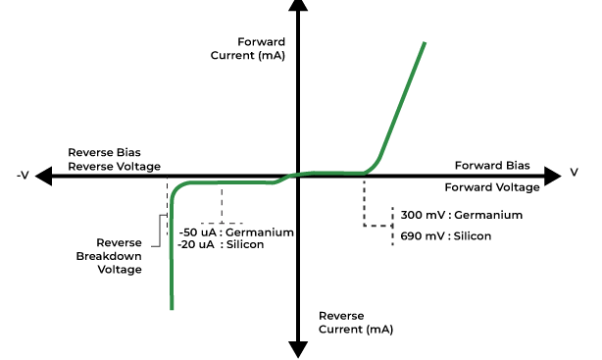
VI Characteristics of Diode
Graph of Current (I) vs. Voltage (V):
Forward Bias: Rapid increase in current after threshold voltage. Threshold Voltage: 0.7V (Si) and 0.3V (Ge).
Reverse Bias: Minimal leakage current until breakdown voltage (Avalanche or Zener breakdown)is reached.

Slide 8
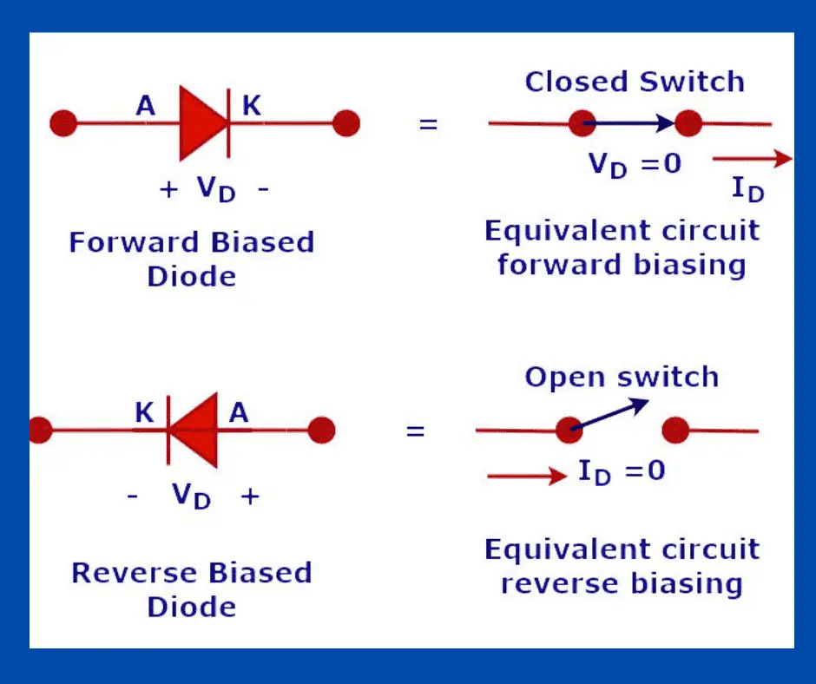
Diode Applications & Diode acts as switch
Basic application: Diode acts as a Switch
Rectification: Converts AC to DC (e.g., Full-Wave and Half-Wave Rectifiers).
Clipping/Clamping: Modifies waveform shapes.
Voltage Regulation: Zener diodes maintain constant voltage.
Signal Mixing/Demodulation: Used in communication circuits.

Slide 9

Diode Current Equation
It describes how the current through a diode responds to the voltage applied across it.
I is the current flowing through the diode
I₀ is the dark saturation current
q is the charge on the electron
V is the voltage applied across the diode
η is the (exponential) ideality factor
K is Boltzmann constant
T is the absolute temperature in kelvin

Slide 10
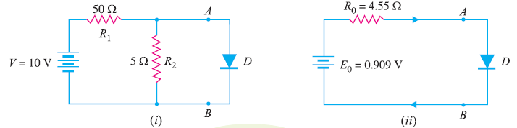
Practice problems
Q1. An a.c. voltage of peak value 20 V is connected in series with a silicon diode and load resistance of
500 Ω. If the forward resistance of diode is 10 Ω, find :
(i) peak current through diode (ii) peak output voltage
What will be these values if the diode is assumed to be ideal ?
Q2. Find the current through the diode in the circuit shown in Fig. (i). Assume the diode to be ideal.
Solutions: https://electronicspost.com/solved-problems-on-semiconductor-diode/

Slide 11
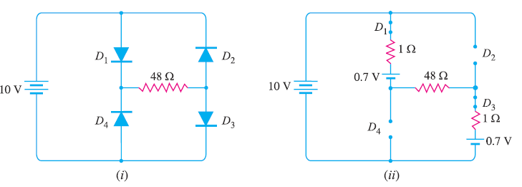
Practice problems
Q3. Calculate the current through 48 Ω resistor in the circuit shown in Fig. 3 (i).
Assume the diodes to be of silicon and forward resistance of each diode is 1 Ω.
Solutions: https://electronicspost.com/solved-problems-on-semiconductor-diode/

Slide 12
SELF-ASSESSMENT QUESTIONS
What is the primary function of a diode in an electronic circuit?
a) Signal amplification
b) Voltage regulation
c) Current multiplication
d) Rectification
In which biasing condition does a diode allow current flow?
a) Forward bias
b) Reverse bias
c) No bias
d) Variable bias

Slide 13
SELF-ASSESSMENT QUESTIONS
3. What is the typical forward voltage drop of a silicon diode?
a) 0.1 V
b) 0.5 V
c) 1.2 V
d) 0.7 V
4. What happens when a diode is in reverse bias?
a) It conducts heavily
b) It acts as a closed switch
c) It blocks current
d) It amplifies the signal

Slide 14
TERMINAL QUESTIONS
1. Describe the formation and characteristics of a PN junction in a diode.
2. List out the factors influencing the depletion region width in a PN junction diode.
3. Analyze the behavior of a PN junction diode under forward biasing conditions.
4. . Analyze the behavior of a PN junction diode under Reverse biasing conditions

Slide 15
REFERENCES FOR FURTHER LEARNING OF THE SESSION
Reference Books:
1. John Bird. Electrical Circuit Theory and Technology, Routledgepublishers, 6th edition,
2. ElectronicDevices and CircuitTheory 12th Edition-Robert L. Boylestad
Sites and Web links:
1. https://www.electrical4u.com/pn-junction/#google_vignette
2. https://www.physics-and-radio-electronics.com/electronic-devices-and-circuits/semiconductor-diodes/barrier-voltage.html

Slide 16

THANK YOU
Team – BASIC ELECTRICAL & ELCTRONIC CIRCUITS

